Slide 1
Personal Email Financial Analysis
Data Science Study Case
Angel Berta Desi Suryanti Puji Resmiati

Slide 2
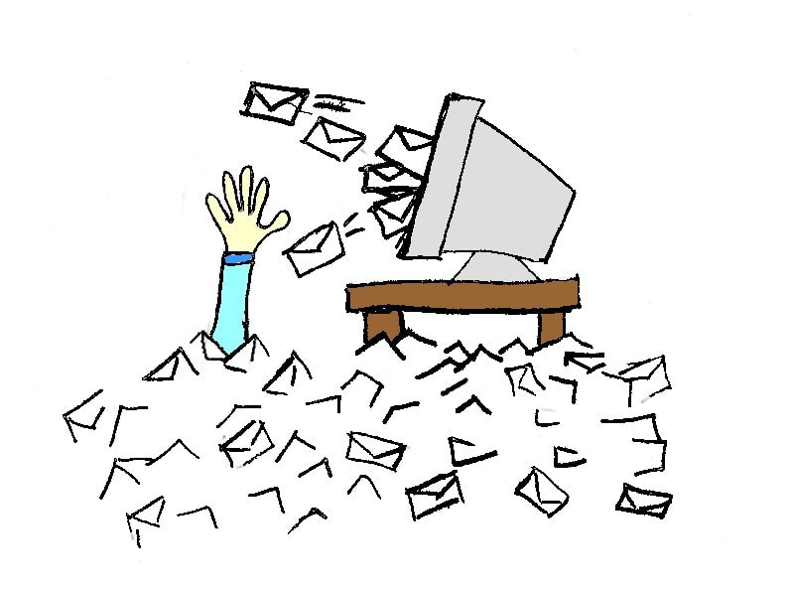



The problem

Slide 3
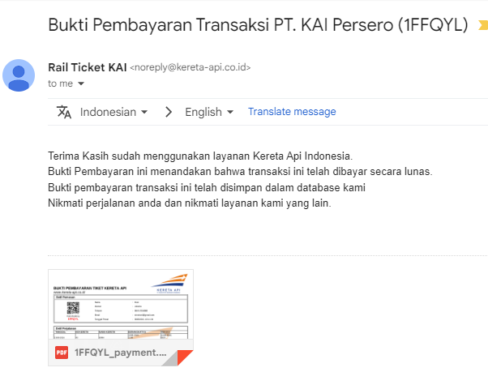
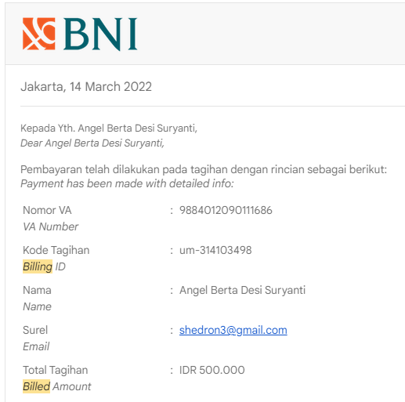
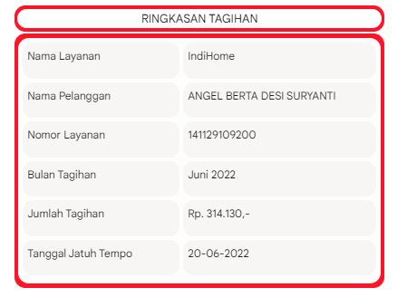
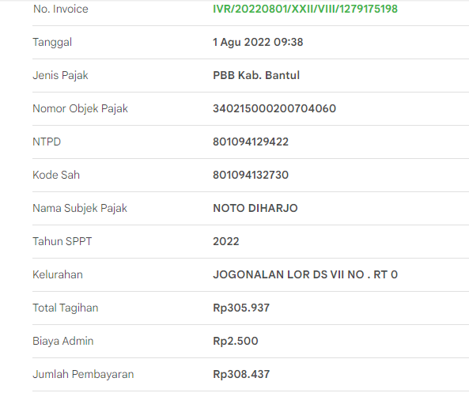
The problem

Slide 4
The problem
Problem statement
There are unorganized email in our GMAIL inbox
Those emails are uncategorized and coming from so many application (e-commerce, entertainment, bank, membership account)
It is hard to analyse the email related to billing and other expenses email

Slide 5
Challenges deep-dive
Challenge 1
Challenge 2
Challenge 3
Data Collection
Found non standard email will give homework to the project
Data Extraction
Body email extraction needs extra care code to process it, and it’s not easy to do it
Data format
Cleansing the data to the standard format is one of thing to do

Slide 6
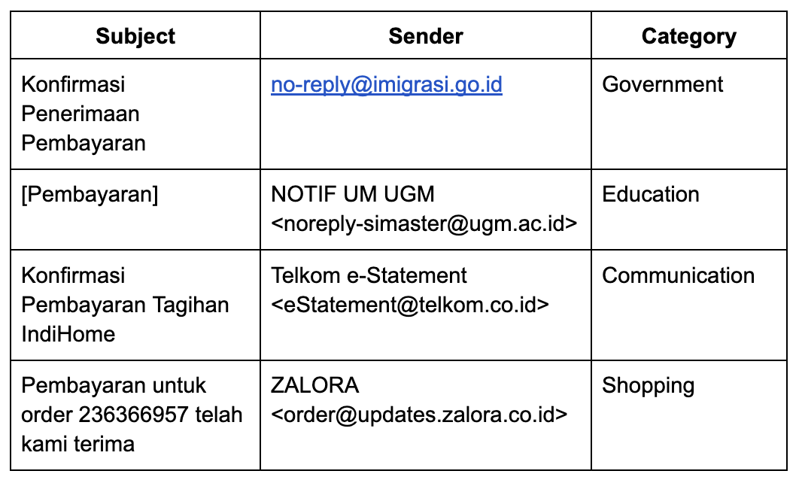
Analysis
Qualitative Analysis

Slide 7
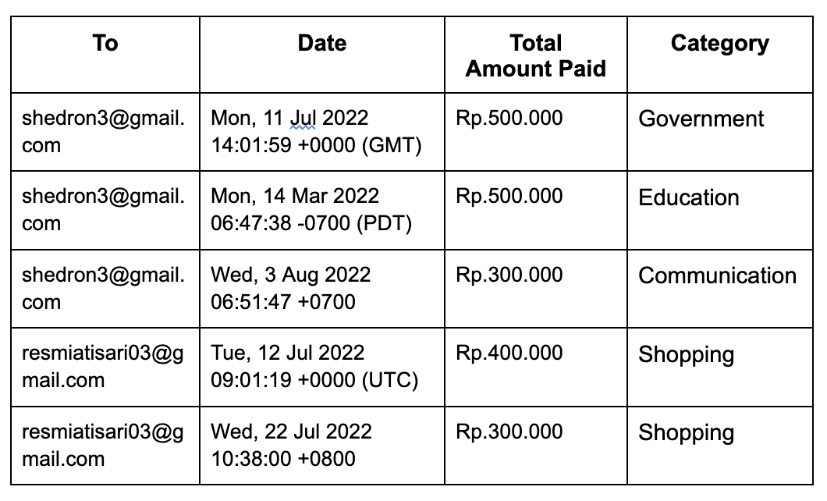
Analysis
Quantitative Analysis

Slide 8
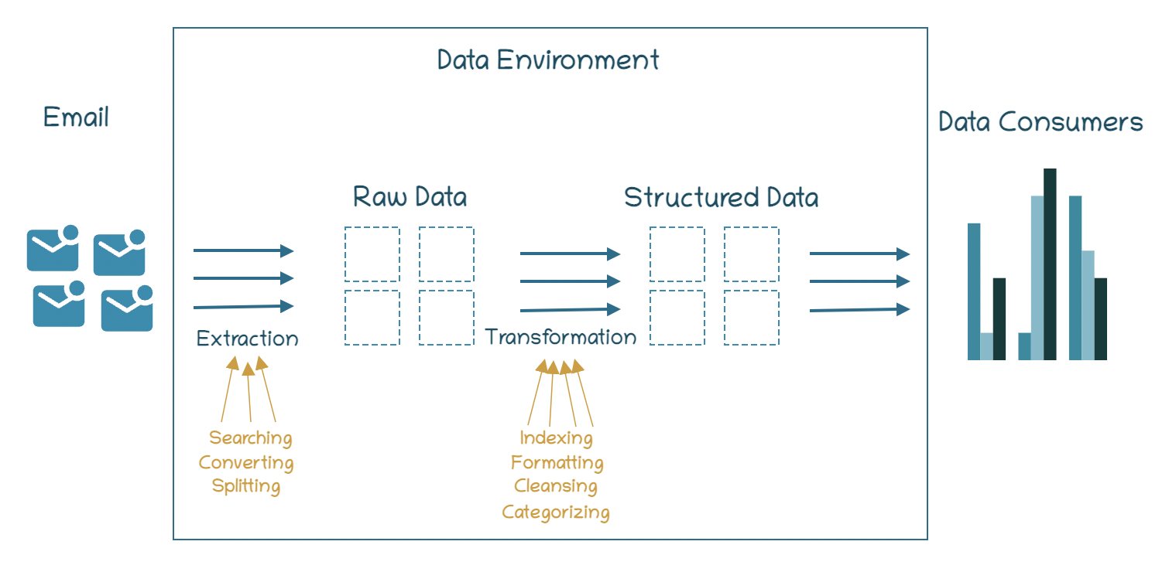
System Design:
Python
Gmail API
BeautifulSoup
Report Design:
Graph
Database Design: Mysql

Slide 9
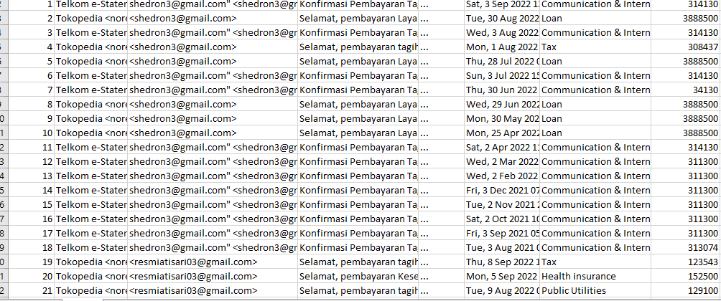
Current Result Design

